Slide 1

HUMAN FACTORS IN MANUFACTURING
Diane Richard
Tri-Association Meeting
November 3, 2015

Slide 2
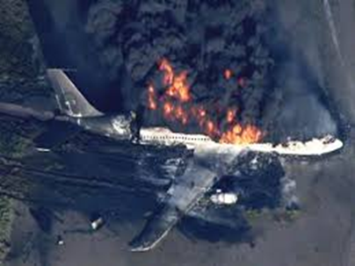
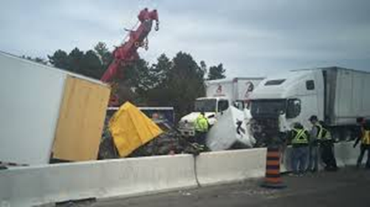
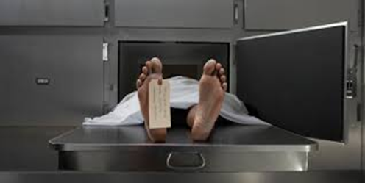
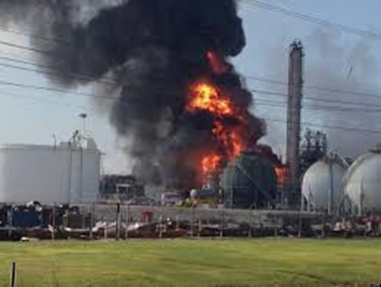
What happened?
Why did it happened ?
How did it happened ?
Who did it happened to ?
What role did human factors play ?

Slide 3
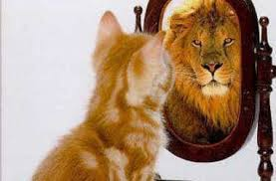

Which is Your Reality?
“Employees are a company's greatest asset - they're your competitive advantage. You want to attract and retain the best; provide them with encouragement, stimulus, and make them feel that they are an integral part of the company's mission.”
Anne Mulcahy, CEO of the Year 2008
“So much of what we call management consists in making it difficult for people to work.”
Peter Drucker, Management Consultant
What portion of your
resources and energy are spent
on physical assets
vs. human assets?

Slide 4

Environment
Inter-
personal
Personal
Human Factors Considerations

Slide 5
Environment

Slide 6

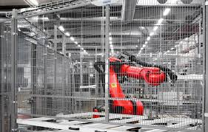





Employees perceive safety is sincerely a priority
Standards known and followed
Training provided
Proactive internal auditing
Robust incident investigation
Industrial hygiene
Employee engagement
Continuous improvement
Key milestones celebrated

Slide 7
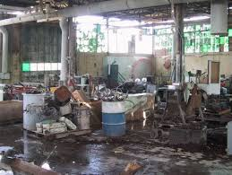
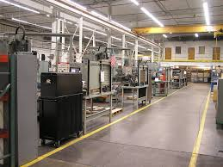
Leverage “5S”
Work should be a sense of pride vs. frustration.
Policies and standards increase consistency and reduce peer conflict.
Job aids and standardization support job rotations.

Slide 8
Personal

Slide 9

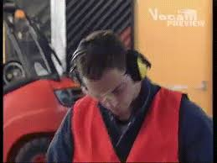





The Need to Always Be Connected

Slide 10

Create Balanced Expectations
“Positive Intent”
“Negative Intent”
Useful productivity apps
Creates flexibility to change schedules through alternate arrangements
Can put mind at ease if something is pending
Connecting adds moments of happiness
Time away from core accountabilities
Expectations to instantaneously respond
Mind not focused on workplace hazards
Connecting adds moments of stress

Slide 11
Tips for Managing Personal Time and Social Media
Lead from values: Safety first
Communicate expectations proactively
Manage outliers quickly and firmly
Infuse day with peer human interactions

Slide 12
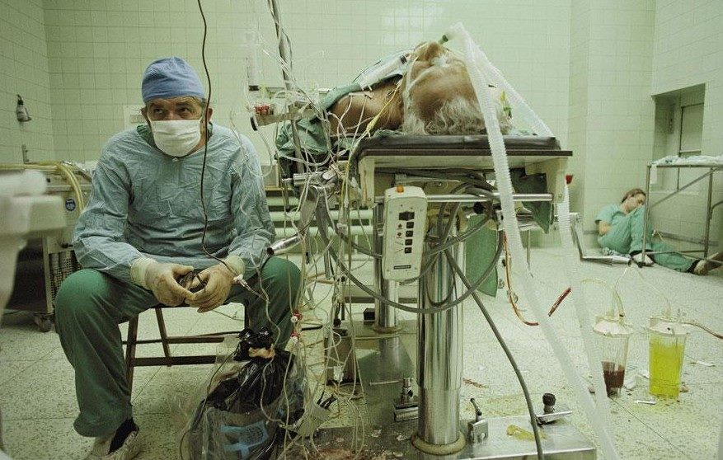

What the Shift Schedule Must Take into Account
Business goals
Operational constraints
Employee preferences
    Ergonomics and repetitive strain
    Human factors considerations of:
Diet
Exercise and sports participation
Community, volunteer involvement
Religious requirements
Family member impact
Social isolation

Slide 13
Your Starting Point Considerations
A Good Start
Time to Re-Consider
Designed for best balance business and human factors
Reflects object business criteria such as infrastructure, capacity, customer requirements.
Is reviewed for relevance on some frequency.
understaffing, absenteeism, retention, quality of supervision/management.
Necessary requirements or charges resulting from
Under-staffing or under-planning
Absenteeism
Retention issues
Worker/management/union conflict
Supervisory leadership skills.

Slide 14
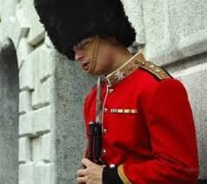
Sharing of Best Practices
What shift configurations do you currently use?
What have you avoided or regretted doing?
What has worked best for you in the past?
      Types of schedules?
      Communications?
      Flexibility or “in lieu of” practices ?
      Managing healthy eating on backshifts ?
      Managing exercise and fatigue
      on extended shifts ?

Slide 15
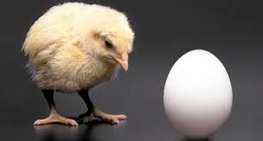
Substance Abuse or Substance Use is Complicated By …
General accessibility to substances
Impact of shift work
Impact of medical marijuana TBD in case law
Inability to screen in Canada
Ties to mental health and wellness….which came first?

Slide 16

What We Know About Mental Illness
In any given week, at least 500,000 employed Canadians
are unable to work due to mental health problems
The economic burden of mental illness is estimated at $51 billion per year. This includes health care costs, lost productivity, and reductions in health-related quality of life.
In Ontario the annual cost of alcohol-related health care, law enforcement, corrections, lost productivity, and other problems is estimated to be $5.3 billion.
A growing body of international evidence demonstrates that promotion, prevention, and early intervention initiatives show positive returns on investment.
Acknowledgement of Post Traumatic Stress Disorder (PTSD)
Dr. Rakesh Jetly June 2015

Slide 17
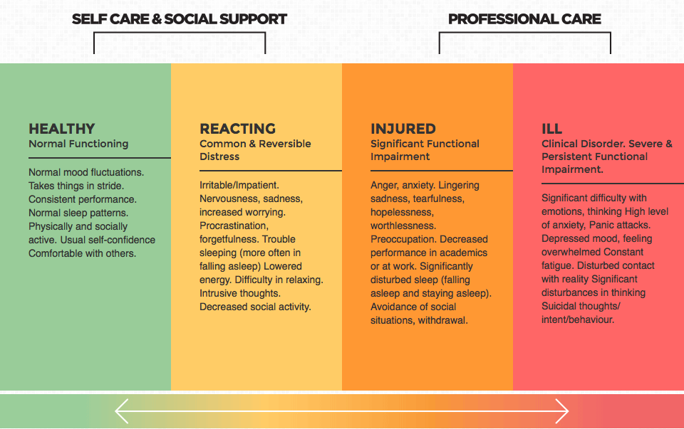
Recognizing the Mental Health Continuum in the Workplace
Dr. Rakesh Jetly June 2015

Slide 18
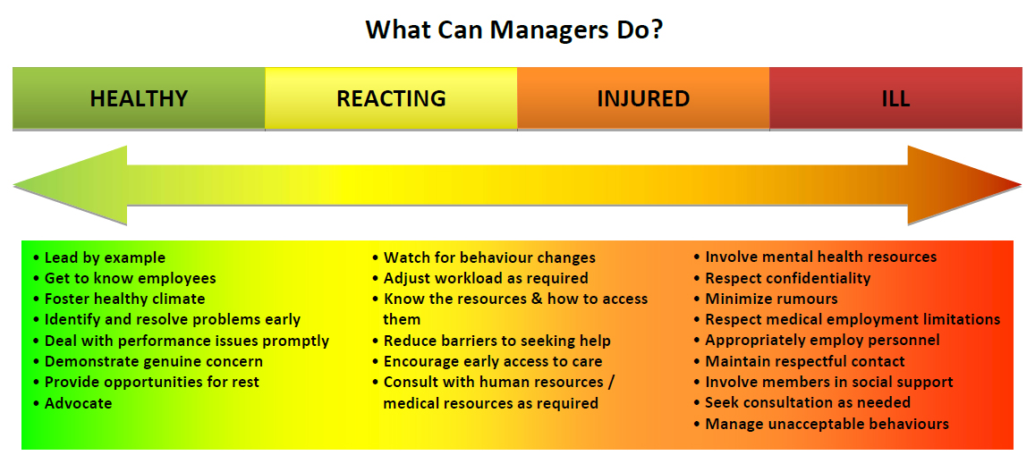
Dr. Rakesh Jetly June 2015

Slide 19
Model for Occupational Health Intervention
Prevention
Leadership
Intervention
Screening
Recovery
Return to work
Policy
Education
Training
Resources
Assessment
Treatment
Family
Peer Support
Monitoring
Relapse prevention
Support
Evaluation
Dr. Ash Bender June 2015

Slide 20
The evolution of the “Plant Nurse”
Over the last 30 years there has been a huge shifts in care and access…
Dedicated nurses with long tenure at the plant crossing multiple shifts. Knew employees well and was excellent quarter-back for Health and Wellness.
Moved to ergonomics resource and then completing company required “Functional Ability Forms”
Moved to outsourcing by large fee for service companies with supposed large team of health professionals to tap into
Moved to front-line supervision needing to be very skilled without the same focus provides by an occupational health specialist.

Slide 21
What You Can Do?
Invest in strong front-line leaders.
Have open conversations.
Have and inforce policies.
Looks for trends and you will see them.
Budget for adhoc expert support proactively when you see the concerning trends.

Slide 22
Inter-
personal

Slide 23
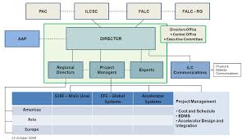
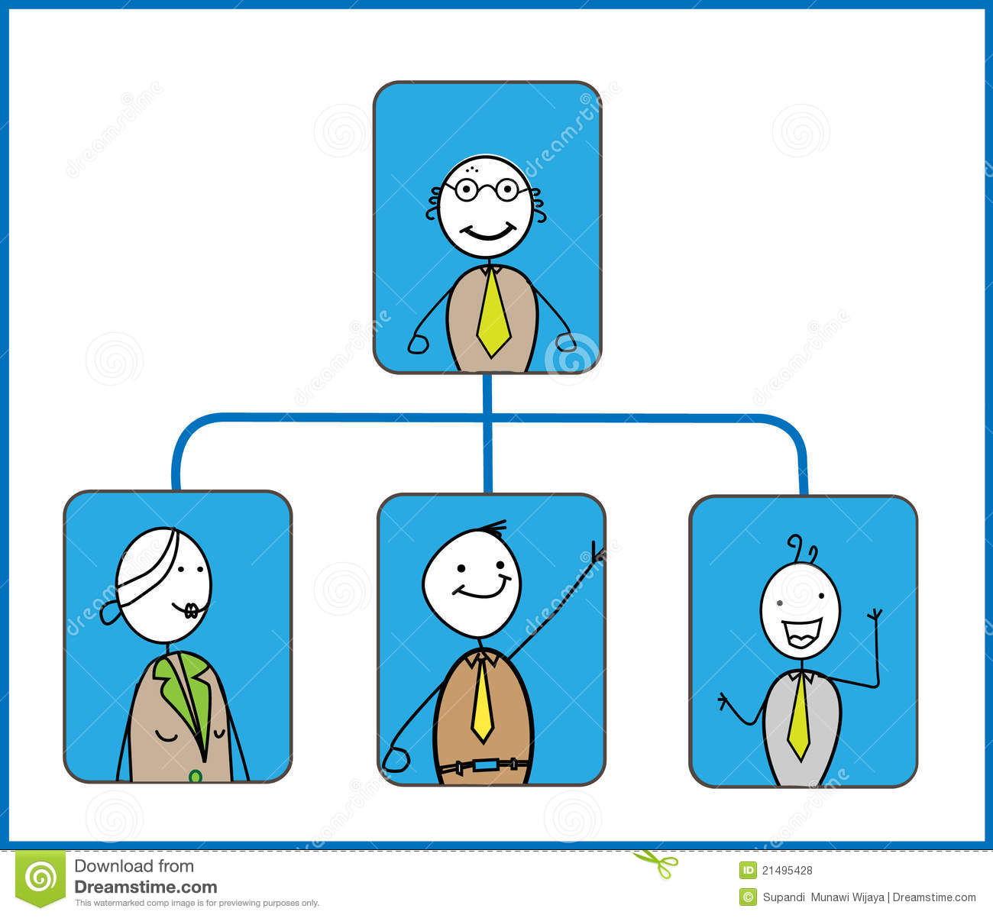
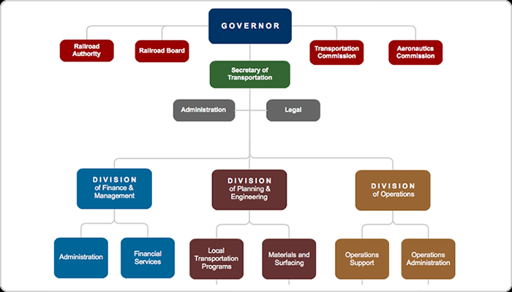
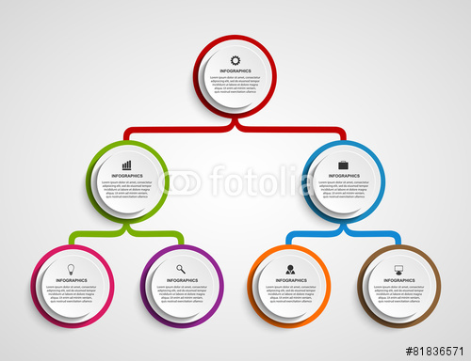
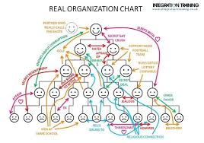
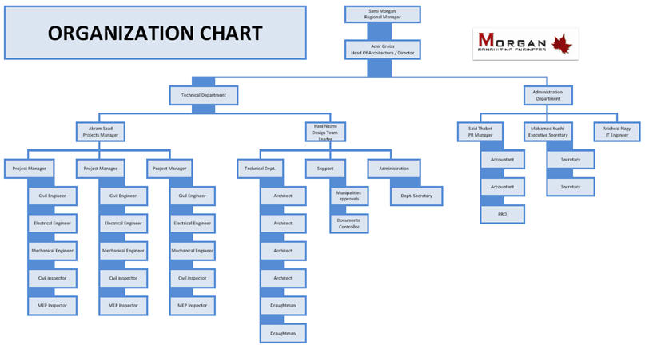
Is Your Organizational Structure Right?

Slide 24
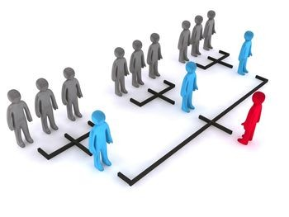
Who Has Your Back?
Tend the garden
Fix the structure
Surround leader with a great support team

Slide 25
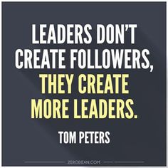

Pick Great Leaders Not Just Managers

Slide 26
Assessing People on Your Team
Functional
Assessment Tool

Slide 27
Assessing People on Your Team
Functional
Assessment Tool
Skills &
Abilities

Slide 28
Assessing People on Your Team
Functional
Assessment Tool
Skills &
Abilities
Effort &
Passion

Slide 29
Assessing People on Your Team
Functional
Assessment Tool
Role Fit
Skills &
Abilities
Effort &
Passion

Slide 30
Leadership Assessment Tool
LOW
HIGH
HIGH
HIGH
HIGH
Transparency
LOW
LOW
HIGH
LOW
LOW
LOW
HIGH
Accountability

Slide 31
Leadership Assessment Tool
.
Sets clear expectations and invests the time
to review and calibrate with reports
HIGH
Transparency
.
LOW
LOW
HIGH
Accountability

Slide 32
Leadership Assessment Tool
Everyone sees that certain individuals not contributing.
Sets clear expectations and invests the time
to review and calibrate with reports
HIGH
Implement an objective performance management system
Transparency
LOW
LOW
HIGH
Accountability

Slide 33
Leadership Assessment Tool
Everyone sees that certain individuals not contributing.
Sets clear expectations and invests the time
to review and calibrate with reports
HIGH
Spend time
with cross-section of organization and be “present” to understand cause and effect
Transparency
Holds people accountable but not well calibrated.
Looks to blame.
LOW
LOW
HIGH
Accountability

Slide 34
Leadership Assessment Tool
Everyone sees that certain individuals not contributing.
Sets clear expectations and invests the time
to review and calibrate with reports
HIGH
Evaluate the risk of having
this leader
in the organization
Transparency
No standards defined or consistency adhered to.
“Favoritism” or earned rights through tenure.
Holds people accountable but not well calibrated.
Looks to blame.
LOW
LOW
HIGH
Accountability

Slide 35

Culture is something you can change quickly
Define future reasons to celebrate which are aligned to your mission
Define what behaviours you will reward which are aligned to your values.
Define what behaviours are “taboo” aligned to your values.
Put in place rituals to monitor that strategies are being effectively implemented.
Notes:
Better picture of compass

Slide 36
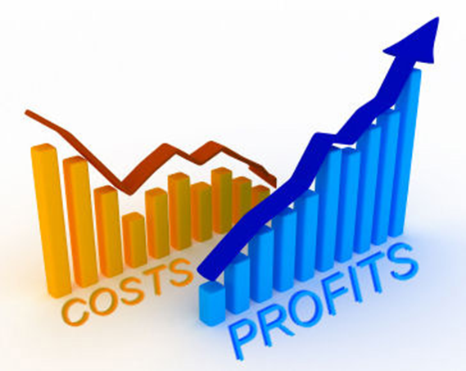

How Might We Take Into Account Human Factors
You have been asked to be on a Steering Team that is building a greenfield, state-of-the art new production facility that is poised to capitalize on a massive export opportunity.
Flawlessly executing and demonstrating continuous improvement in a highly competitive global market is imperative to be successful.
You are in a working session determining the investments in your staffing and considering the return on investment for each.

Slide 37
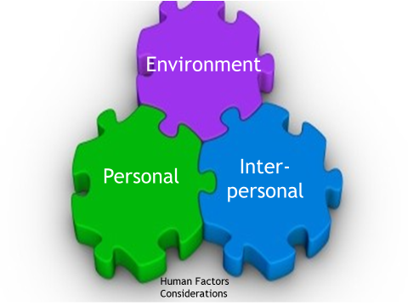
What Would Your 3 Highest Ranking Priorities Be?
Environmental
  A well balanced safety program including policies on use of mobile devices
  A robust 5S program
  Other?
Personal
  Alternative or flexible shift options
  Facilities and flexibility to support healthy eating and exercise
  Training for supervision including 3rd party resources to support substance abuse and mental health
  Other?
Interpersonal
  Leadership investment in managing against Vision, Mission, Values, Culture
  Hiring of “Top Tier” leadership with demonstrated success in talent development and performance management
  Rewards and recognition program
  Other?

Slide 38

Human Factors In Manufacturing
Have a set of values to live by
Start by having the conversation
Calibrate where you really are
Make one simple change today
“Leaders think and talk about the solutions. Followers think and talk about the problems.”
Brian Tracy Organizational Trainer

Slide 39
Low (L) = Lacking
Medium (M) = Opportunity for Improvement
High (H) = A strength to preserve
Diane Richard
diane@diatomconsulting.ca

