Slide 1
Cap and Trade;
What Does it Mean For Your Organization?
Presented to Members of the Northumberland Manufacturers Association

Slide 2
Presentation Overview
What are Greenhouse Gases?
Carbon Dioxide Equivalency
Carbon Tax vs. Cap and Trade System?
Relevant regulations under EPA
Ontario’s Approach
What does the new cap and trade system mean for small and medium size manufacturers?
Green House Gas (GHG) management
Examples of carbon offset projects
Notes:
Applies to 60 and 75

Slide 3
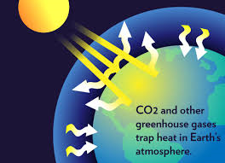
Greenhouse Gas
(GHG) Definition
Any of the atmospheric gases that contribute to the greenhouse effect by absorbing infrared radiation produced by solar warming of the Earth's surface. They include carbon dioxide (CO2), methane (CH4), nitrous oxide (NO2), and water vapor.
Source: Google Definitions

Slide 4
Why do We care About GHGs?
Aside from the climate science, Canada has committed to GHG reduction (Paris 2015) with the United Nations
Obviously federal commitments will trickle down to the province
Notes:
3.8MT reduce by in Ontario by 2020

Slide 5
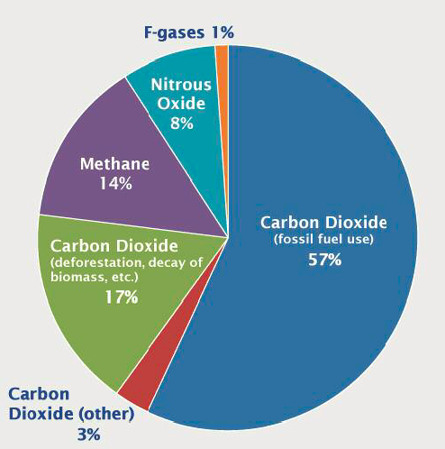
GHG Emission Gases
Source: US EPA

Slide 6
Carbon dioxide equivalency
A quantity that describes, for a given mixture and amount of greenhouse gas, the amount of CO2 that would have the same global warming potential (GWP), when measured over a specified timescale (generally, 100 years).
Source: Wikipedia
Notes:
“Carbon dioxide equivalents” is a unit of measurement that allows the effect of different greenhouse gases and other factors to be compared using carbon dioxide as a standard unit for reference.
In the context of emissions of greenhouse gases, “carbon dioxide equivalents” refers to the amount of carbon dioxide that would give the same warming effect as the effect of the greenhouse gas or greenhouse gases being emitted.
The Keeling Curve is a graph which plots the ongoing change in concentration of carbon dioxide in Earth's atmosphere since 1958.

Slide 7
Carbon dioxide equivalency
What this means is that some chemicals have more of an effect on the atmosphere than carbon dioxide.
Examples:
  Methane is considered to have 21 times the warming potential that carbon dioxide has; therefore, 1 tonne of methane would be considered 21 tonnes of carbon dioxide.
  1 single tonne of sulfur hexafluoride would be equivalent to 23,900 tonnes of carbon dioxide
Source: Wikipedia
Notes:
“Carbon dioxide equivalents” is a unit of measurement that allows the effect of different greenhouse gases and other factors to be compared using carbon dioxide as a standard unit for reference.
In the context of emissions of greenhouse gases, “carbon dioxide equivalents” refers to the amount of carbon dioxide that would give the same warming effect as the effect of the greenhouse gas or greenhouse gases being emitted.
The Keeling Curve is a graph which plots the ongoing change in concentration of carbon dioxide in Earth's atmosphere since 1958.

Slide 8
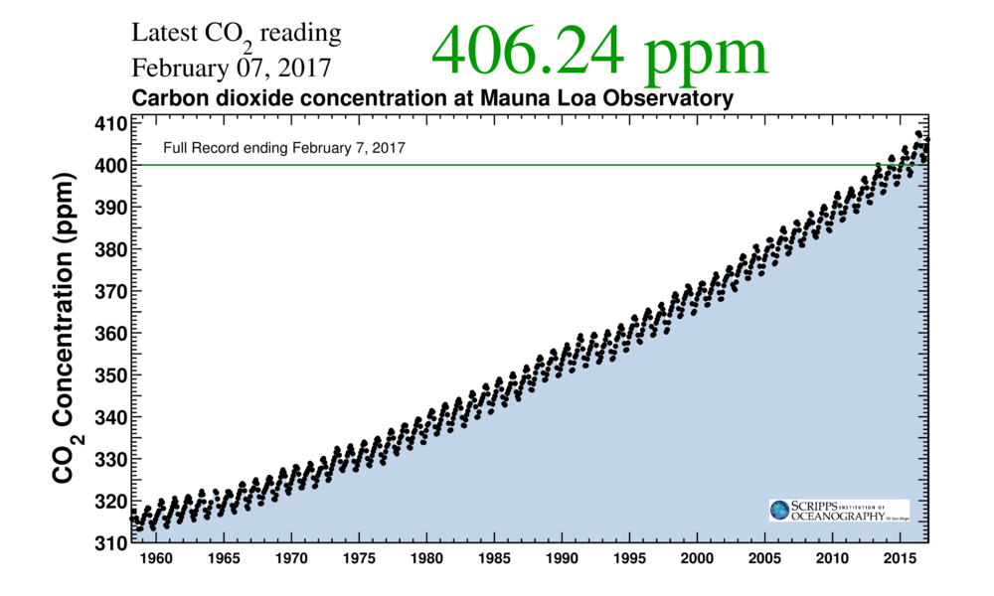
Keeling Curve

Slide 9
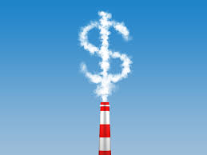
Carbon Tax Definition
A carbon tax is usually defined as a tax based on greenhouse gas emissions (GHG) generated from burning fuels
  It puts a price on each tonne of GHG emitted
  Over time should produce a market response resulting in reduced emissions
Notes:
Simple system, easily applied to the market

Slide 10
Cap and Trade Definition
Sources (i.e. companies) covered by the program receive authorizations to emit in the form of emissions allowances, with the total amount of allowances limited by the cap.
Each facility can design its own compliance strategy to meet the overall reduction requirement which may include:
  the sale or purchase of allowances,
  installation of pollution controls,
  implementation of efficiency measures, etc.
Notes:
Complicated system, creates much more work for consultants in reporting, verification, as well as government jobs in enforcement and management. A very complex system with the intended goal to reduce emissions.

Slide 11
Cap and Trade Basics
Inventory of emissions established through reporting.
Government sets cap on emissions.
Over time, cap is lowered.
Cap is divided into units called “allowances”, equal to 1 tonne of CO2-e each.
Government distributes allowances either free of charge or by auction.
Notes:
Free of charge is to start, it will slowly reduce the amount of free of charge credits.

Slide 12
Cap and Trade Basics Cont’d
Offset credits introduced for emissions reductions/removals that occur outside of the regulated scope.
Allowances and offsets bought and sold.
Facilities need to acquire enough allowances and/or offset credits to cover their emissions.
The overall idea is that Cap-and-trade will harness the power of the marketplace to reduce emissions efficiently.
Notes:
The intention is that basic capitalism will create the conditions where facilities will want to get more efficient and reduce emissions to avoid the costs of buying allowances or offsets.

Slide 13
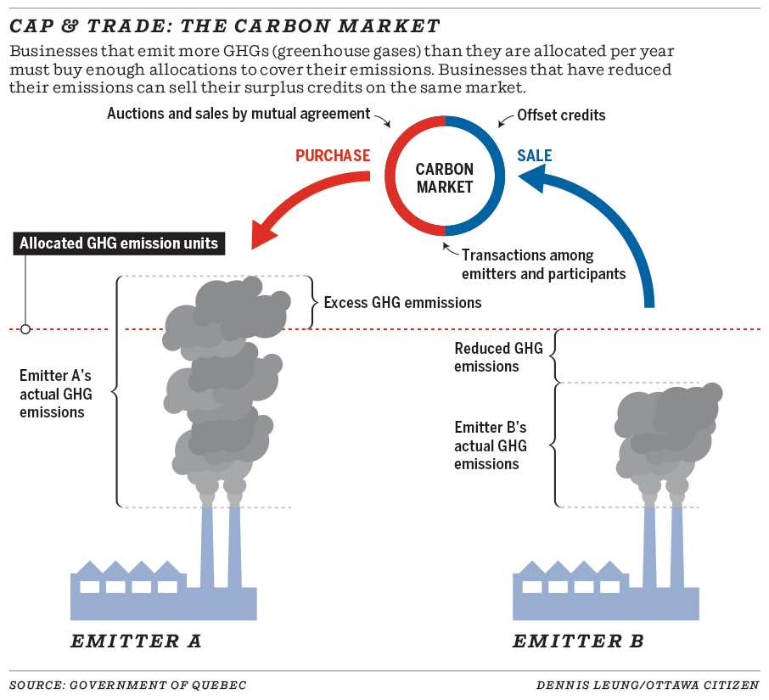
Source: MOECC

Slide 14
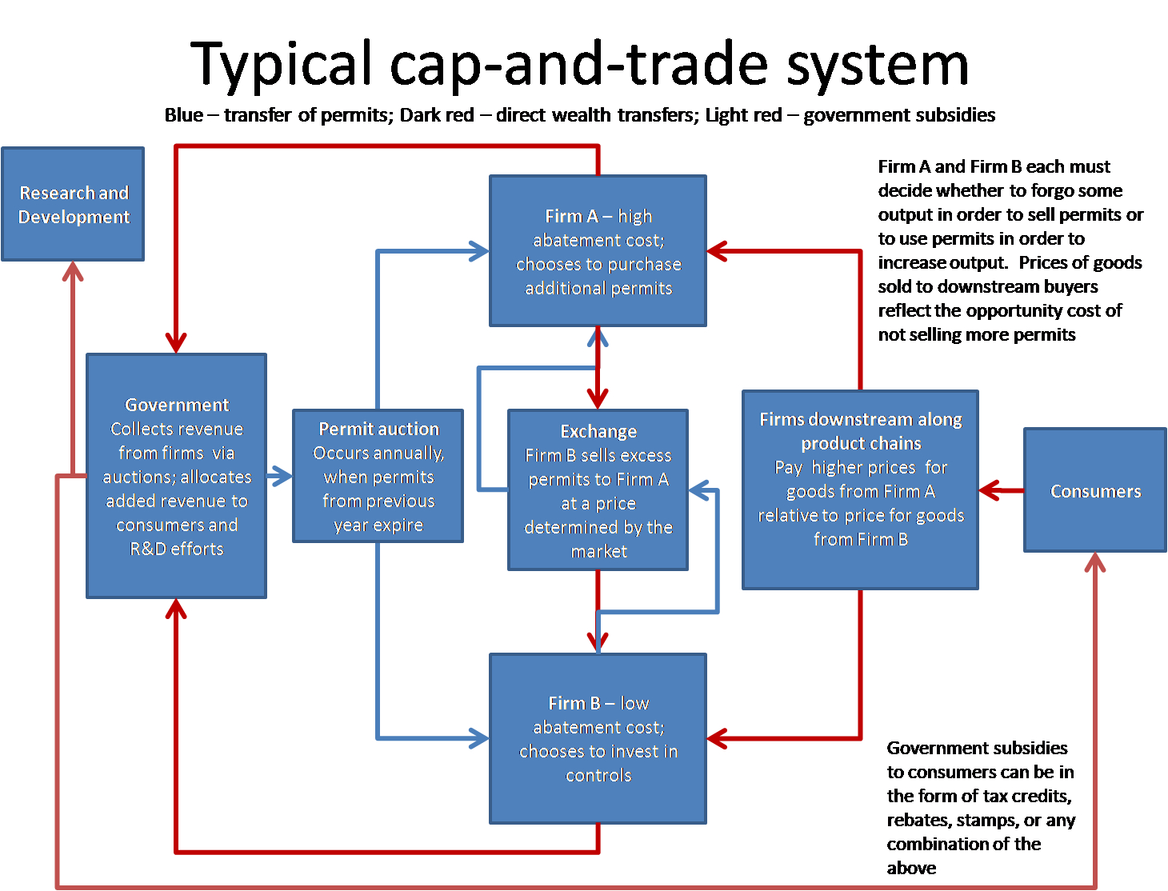

Slide 15
What is the Difference?
Carbon taxes are what they sound like: a fixed levy on carbon emissions.
  For example, British Columbia has a carbon tax of $30 per tonne of carbon dioxide, which is about seven cents per litre of gas.
In contrast, Cap and Trade means that the government sets an overall cap on emissions, breaks that up into allowances and then lets companies trade them.
Notes:
In theory, the two systems can be shown to be equivalent: the same prices generating the same revenues for the government while giving the same reductions in emissions. And in practice, both cap and trade and carbon taxes are market-based, and either is better for the economy than a purely command-and-control approach. Finally, both theory and evidence suggest that if they’re designed well, both systems can reduce emissions.

Slide 16
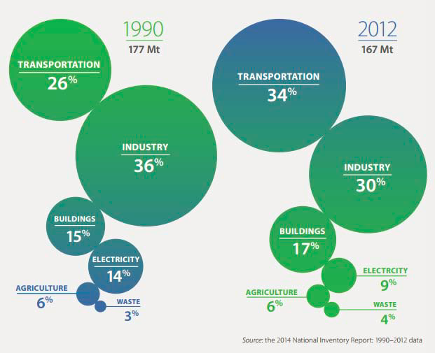
Ontario Emissions History
Notes:
As much as people seem to indicate cow manure is the cause of global warming, you can see that its really transportation, industry, then heating

Slide 17
Regulations Targeting Emitters in Ontario Include:
Greenhouse Gas Emissions Reporting – O. Reg. 452/09
  What must a prescribed facility do?
    collect emissions data
    prescribed facilities emitting ≥ 10 kt/yr of CO2e required to report (down from 25 kt)
    annual emissions reporting by June 1 in calendar year following reporting period
    facilities emitting ≥ 10 kt/yr and < 25 kt/yr do not need verification by September 1
Notes:
Applies to prescribed facilities such as:
Hydrogen production
Lime manufacturing
Iron manufacturing
Nickel production
Steel manufacturing
Petroleum refining
Lead production
Pulp and paper manufacturing
- There is a guideline of standardized methods that must be used for measuring emissions
- Required Third party verification by September 1st of subsequent year

Slide 18
Additional Emissions Reporting Regulations
Environmental Compliance Approvals (ECA) – O. Reg. 419/05
Environmental Activity and Sector Registry (EASR) – O. Reg. 1/17
National Pollutant Release Inventory (NPRI) – Environment and Climate Change Canada (Federal)
Toxics Reduction Act (TRA) – O. Reg. 455/09

Slide 19
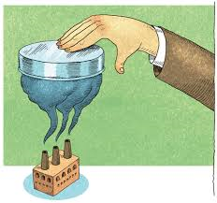
Ontario’s Next Target
March 2015: Ontario Government announces intentions to implement carbon pricing scheme.
April 2015: Ontario Government announces it will develop a cap-and-trade program that can link to the existing programs in Québec and California.
  The draft regulation was released on February 25, 2016
Notes:
Very fast implementation of a very complicated system. Guidance was coming out mere months before implementation.

Slide 20
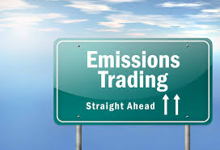
Ontario's Next Target Cont.
The Cap and Trade Program – O. Reg. 144/16 – Jan 2017
Compliance Offset Credits Regulatory Proposal – In Draft

Slide 21
Ontario's Next Target Cont.
First practice auction was in January 2017
Real auction upcoming in March 2017
Initially the first year will effectively have no reduction, allowing businesses to get used to the system

Slide 22
the Cap is Now Set to be Reduced
Initial cap set to match starting inventory.
Caps in Quebec and California decline at more than 3% per year.
Cap decline of 2-3% per year could put Ontario on track to meet 2020 target.

Slide 23
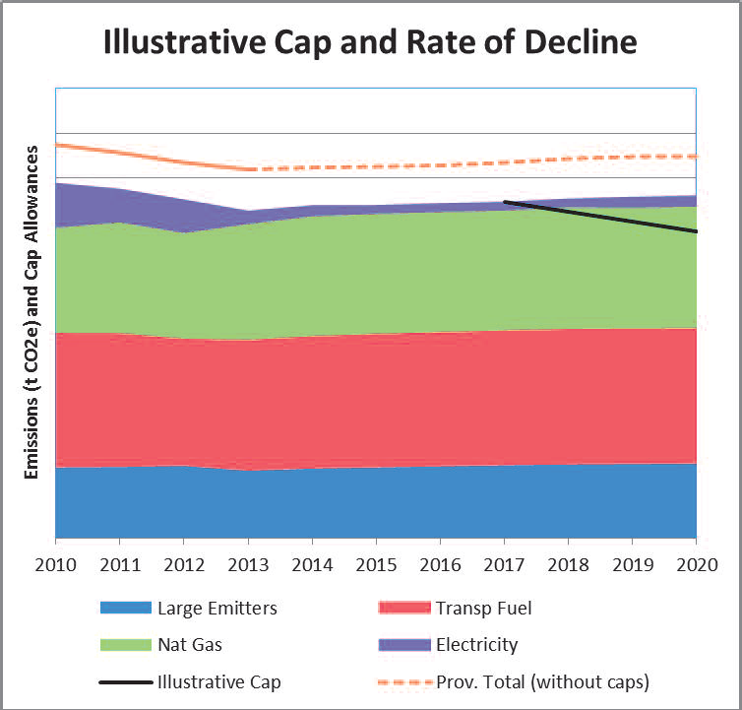

Slide 24
Distribution of Allowances
Government will distribute allowances at auction and free-of-charge.
  Free-of-charge for trade-exposed emitters, including most industry.
  Auctions for non-trade exposed sectors, including fuel distributors and electricity generators.
  Practice auction occurred January 2017
Allocations need to accommodate growth and new entrants.

Slide 25
Roles of Key Players
Government
  Sets the cap and scope: regulated sectors/sources
  Allocates allowances (free or by auction)
  Establishes program/market rules and monitors compliance
Emitters and Fuel Distributors
  Determine the most efficient way to comply
  Reduce emissions or buy allowances or offsets
  “Submit” allowances and offset credits at end of compliance cycle
Administrative Organization
  Manage auctions, financial settlements, tracking system, market monitoring
Notes:
So it appears cap and trade also functions as a job creation effort.

Slide 26
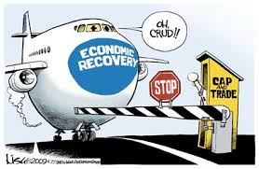
What does the new Cap and Trade system mean for small and medium size manufacturers?

Slide 27
When does a facility “need” to Participate?
Mandatory participation at threshold of 25,000 tonnes of carbon equivalent emissions for specific operations
O. Reg. 452/09 states that if a person owns or operates a facility at which a Table 2 activity is engaged in within the calendar year, GHG emissions need to be quantified and reported on for emissions >10,000 tonnes
Other activities in which a report is required includes:
  A person who engages in electricity importation (greater than zero megawatt hours)
  A person who engages in natural gas distribution (greater than or equal to 25,000 tonnes of CO₂e)
  A person who engages in petroleum product supply (supplies 200 litres or more of petroleum products during the year)
Notes:
Emphasize the regulation does not look at GHG emission holistically but by specific operations

Slide 28
Table 2 activities
1. Adipic acid production.
2. Ammonia production.
3. Carbonate use.
4. Cement production.
5. Coal storage.
6. Copper and nickel production.
7. Electricity generation.
8. Ferroalloy production.
9. General stationary combustion.
10. Glass production.
11. HCFC-22 production and HFC-23 destruction.
12. Hydrogen production.
13. Iron and steel production.
14. Lead production.
15. Lime production.
16. Magnesium production.
17. Nitric acid production.
18. Operation of equipment for a transmission system or a distribution system (electricity).
19. Operation of equipment related to natural gas.
20. Petrochemical production.
21. Petroleum refining.
22. Phosphoric acid production.
23. Primary aluminum production.
24. Pulp and paper production.
25. Refinery fuel gas use.
26. Soda ash production.
27. Zinc production.
Notes:
All these activities have specific direction on how to calculate GHG emissions

Slide 29
Emissions of Concern
Combustion emissions
  Burning fuel for heating or industrial furnaces
    Roughly 13 million cubic metres per year of natural gas combustion would push a facility into the category of being required to quantify and report
Process emissions in Table 2
  Emissions from chemical or physical reactions as part of production

Slide 30
Further Participation Requirements:
Mandatory reporting but voluntary participation at threshold of 10,000 tonnes of carbon equivalent.
  Equivalent of roughly 5 million cubic metres of natural gas or 20 million BTU per hour; i.e. potentially business with:
    large boilers, or
    high make up air requirements, or
    process heating requirements

Slide 31
Direct Impact on SME’s
Most small and medium size businesses will not be required to enter the system as emitters.
Main impact for small business will be the increased cost of natural gas, electricity, and any other fuels.
Business will also need to quantify their emissions.
Notes:
Depending on their size some companies would likely want to have a does not meet criteria report on hand year to year.

Slide 32
Expected Impact to Energy Related Costs
Union Gas is predicting a 3.3 cent increase per cubic meter of natural gas; This is a 30% increase.
The auditor general estimates hydro costs will increase by 14%.
Retail gas is estimated by the province to go up 4.3 cents per litre (experience at the pump would seem to indicate even higher).
Notes:
ON top of specific energy related costs companies should consider the indirect energy related costs (shipping costs, costs of raw materials)

Slide 33
Managing Your Exposure
How can SME’s manage their exposure to climate risks and related regulatory risks?
Businesses need to be aware of their greenhouse gas emissions on an annual basis and what operations fall under the required reporting.
If an SME is approaching 10,000 tonnes of GHG emissions it would potentially be in their interest to increase efficiency to remain below the reporting threshold.

Slide 34
Managing Exposure Cont’d
Increase efficiency now to reduce the pain of increased gas and hydro costs.
Regulatory risks would include not reporting if you do exceed the threshold; you can likely expect heavy fines to be incurred.
Businesses should be aware that the government will use different databases to identify non-compliance.
  More and more a company with an ECA is being targeted for NPRI; then through NPRI targeted for TRA and/or GHG reporting.
  Electronic Databases and tracking are making it easier to identify and catch out of compliance operations.
Notes:
Cambium has direct client experience with facilities who have been identified through the database reviews

Slide 35
How to Manage Greenhouse Gas
Become aware of your greenhouse gas emissions.
  Inventory of operations and potential sources of emissions.
Determine your annual emissions.
Find efficiencies to reduce by updating combustion equipment, adding emission controls, etc.
Notes:
Compare your operations to regulation 452/09 table 2, take a look at how much natural gas you are burning.

Slide 36
Opportunity to Sell Offset Credits
Aside from increased costs for small to medium businesses there may be an opportunity to create carbon offsets to sell within the greenhouse gas market.
  “Facilities and sectors not subject to the cap and trade regulation that are able to reduce greenhouse gases in accordance with the proposed requirements and associated protocols will be eligible to seek to have offset credits created and issued. Offset Credits may be used by capped facilities to meet up to 8% of a compliance obligation.”
Notes:
The process is still very new, unclear and appears to be fairly complex; still in draft

Slide 37
Offset Credit Projects
Offset projects are emissions reduction or removal initiatives undertaken by entities outside the sectors covered by cap-and-trade.
  Agriculture
  Forestry
  Waste
  Other
Government certified offset credits can be used by facilities in covered sectors as an alternative to allowances.

Slide 38
Offset Credit Projects
Currently the Government is looking at 13 offset protocols, expects to have 3 in place by early 2017.
There may be an opportunity in the future to propose offset projects outside the 13 protocols.

Slide 39
Specific GHG Management and Carbon Offset Projects
In California:
  Reforestation, Forest management or avoided conversion projects
  Urban forest, tree planting in municipalities
  Manure Management Projects
  Ozone depleting substances – capture and destruction of foam blowing substances, and refrigeration agents
  Mine Methane Capture

Slide 40
Specific GHG Management and Carbon Offset Projects
In Quebec:
  Manure Methane management
  Landfill Methane destruction
  Ozone depleting substances (insulating foam and refrigerants from appliances)
  Active coal mines; destruction of methane from drainage system
  Destruction of methane from ventilation air

Slide 41
Penalties for Non-Compliance
What if an emitter does not comply?
  Offence under Ontario’s EPA
  Penalties (first offence)
    Individuals: fine up to $50,000
    Corporations: fine up to $250,000
Penalties increase with subsequent offences and may include greater fines and/or imprisonment
Directors & Officer’s liability
Source: Willms & Shier Environmental Lawyers LLP

Slide 42
A Positive Spin…
“The government will reinvest the money raised through cap and trade in a transparent way back into projects that reduce greenhouse gas pollution and help businesses remain competitive”
Notes:
Minister of Environment and Climate Change, Glen Murray: An example is given of geothermal heating, a technology that hasn’t yet been exploited in Ontario as much as it could be. Once a family has a geothermal system in place in their home, their heating costs go way down. But it’s that initial outlay that deters people. So cap and trade will have two effects: one on the one hand, it will likely raise the costs of the old, emission-intensive technology relative to the new tech. On the other hand, it will provide the government with revenues it can then use to help people pay for projects like geothermal heating.

Slide 43
Why is this Positive?
If those “projects” include things that the government would have spent money on anyway, one could argue that cap and trade is going to create the beginnings of tax-shifting in Ontario.
If the government brings in more revenue from a carbon price, it doesn’t need to raise income or other taxes.
Notes:
The hope is for a tax shift in Ontario and that income and other taxes may go down if the govn’t is getting revenue elsewhere.

Slide 44
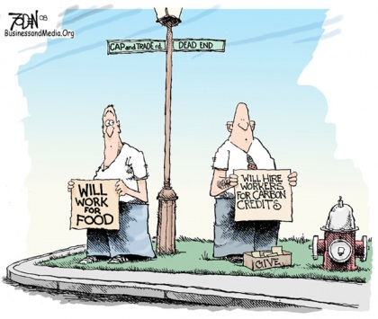

Slide 45
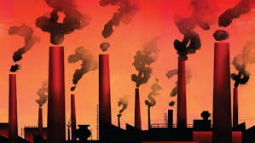
Thank You! Any Questions?
Sadie Bachynski, P.Eng.
Sadie.Bachynski@cambium-inc.com
705-742-7900 ext. 213
Jim Bailey, P.Eng.
Jim.bailey@cambium-inc.com
705-742-7900 ext. 201

